Slide 1
Capstone Project – 3 Supervised ML – Classification Credit Card Default Prediction
By- Avinash Yadav Deepika Yadav

Slide 2

Presentation Outline
Problem Statement
Introduction
Data Summary
Methodology
Exploratory Data Analysis
Data Processing
Implementing ML algorithms
Challenges
Conclusion

Slide 3

Problem Statement: This project is aimed at predicting the case of customers default payments in Taiwan. From the perspective of risk management, the result of predictive accuracy of the estimated probability of default will be more valuable than the binary result of classification – credible or not credible clients. We can use the K-S chart to evaluate which customers will default on their credit card payments.

Slide 4

Introduction: Credit card fraud is a huge ranging term for theft and fraud committed using or involving at the time of payment by using this card. The purpose may be to purchase goods without paying, or to transfer unauthorized funds from an account. Credit card fraud is also an add on to identity theft. The data related to customer are very huge so various data classification techniques are to be included. The Machine learning domain plays a major role in various application like medical, theft identification, forest fire, human detection, networking and so on. . Ensemble approaches are meta-algorithms incorporating many techniques of machine learning into one predictive model to reduce unreliability (bagging), bias (boosting), or improve predictions (stacking). Ensemble methods can be classified into two groups namely sequential set methods and parallel set method.

Slide 5

Exploring the Dataset

Slide 6

Data Summary: ➢ X1 -Amount of credit(includes individual as well as family credit) ➢ X2 -Gender ➢ X3 -Education ➢ X4 -Marital Status ➢ X5 -Age ➢ X6 to X11 -History of past payments from April to September ➢ X12 to X17 -Amount of bill statement from April to September ➢ X18 to X23 -Amount of previous payment from April to September ➢ Y -Default payment

Slide 7
Features:
ID: ID of each client
LIMIT_BAL: Amount of given credit in NT dollars (includes individual and family/supplementary
credit
SEX: Gender (1=male, 2=female)
EDUCATION: (1=graduate school, 2=university, 3=high school, 4=others, 5=unknown, 6=unknown)
MARRIAGE: Marital status (1=married, 2=single, 3=others)
AGE: Age in years
— —
PAY_0: Repayment status in September, 2005 (-1=pay duly, 1=payment delay for one month,
2=payment delay for two months, … 8=payment delay for eight months, 9=payment delay
for nine months and above)
PAY_2: Repayment status in August, 2005 (scale same as above)
…;
PAY_6: Repayment status in April, 2005 (scale same as above)

Slide 8
Features(Contd.):
BILL_AMT1: Amount of bill statement in September, 2005 (NT dollar)
BILL_AMT2: Amount of bill statement in August, 2005 (NT dollar)
…;
BILL_AMT6: Amount of bill statement in April, 2005 (NT dollar)
— —
PAY_AMT1: Amount of previous payment in September, 2005 (NT dollar)
PAY_AMT2: Amount of previous payment in August, 2005 (NT dollar)
…;
PAY_AMT6: Amount of previous payment in April, 2005 (NT dollar)
— —
Default payment next month: Default payment (1=yes, 0=no)

Slide 9


Slide 10
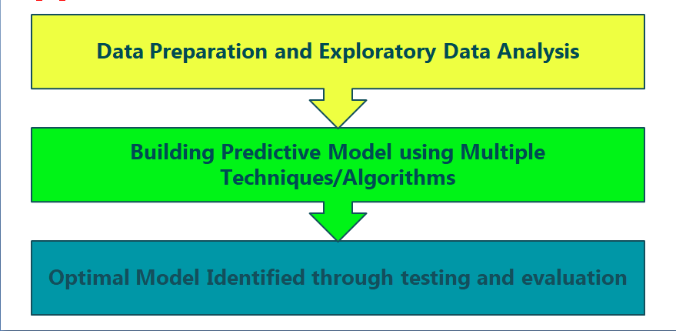
Approach:

Slide 11

EDA AND DATA PROCESSING

Slide 12
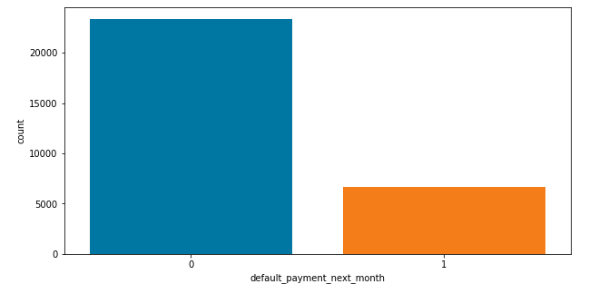
ANALYSIS OF DEPENDENT VARIABLE
As we can see from above graph
that both classes are not in
proportion and we have
imbalanced dataset. We need to
do normalize the data in next
step.
0 - Not Default
1 – Default
Defaulters are less than the
Non Defaulters in the given
dataset.

Slide 13
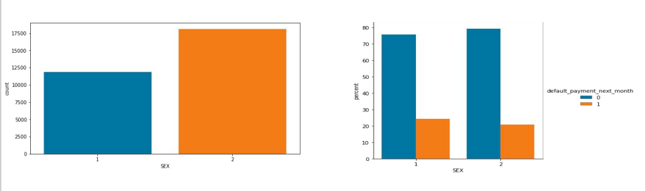
ANALYSIS OF SEX VARIABLE
1 - Male
2 - Female
Number of Male credit holder is less than Female.
It is evident from the above graph that the number of defaulter have high proportion of males

Slide 14
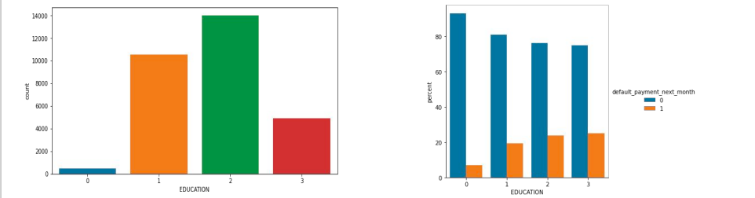
ANALYSIS OF EDUCATION VARIABLE
1=graduate school, 2=university, 3=high school, 0=others
From the above left side plot we can say that more number of credit holders are university students followed by Graduates and then High school students.
From the right side plot it is clear that those people who are other students have higher default payment w.r.t. graduates and university people.

Slide 15
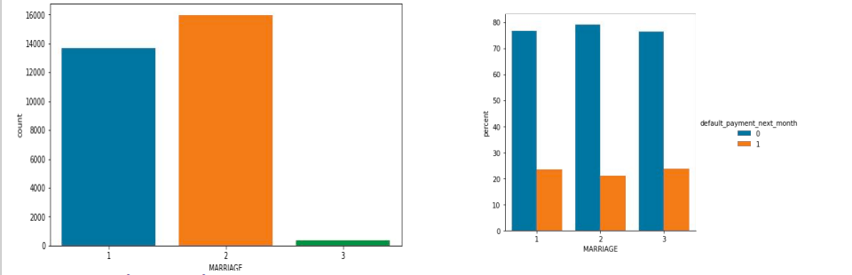
ANALYSIS OF MARRIAGE VARIABLE
1 – married, 2 – single, 3 - others
From the above data analysis we can say that
More number of credit cards holder are Single.
High defaulter rate when it comes to other

Slide 16
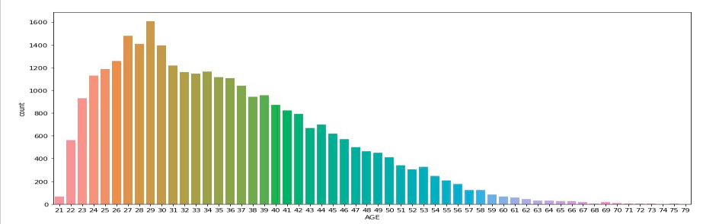
ANALYSIS OF AGE VARIABLE
From the above count plot analysis we can say that
We can see more number of credit cards holder age are between 26-30 years old.
Age above 60 years old rarely uses the credit card.

Slide 17
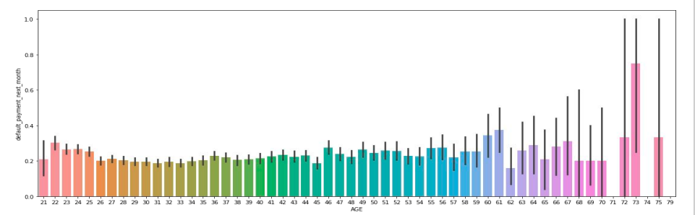
ANALYSIS OF AGE VARIABLE
From the above bar plot which shows the relationship between age and defaulter, we can say that those who default are 60 years and older, that may be they don’t use their card frequently

Slide 18
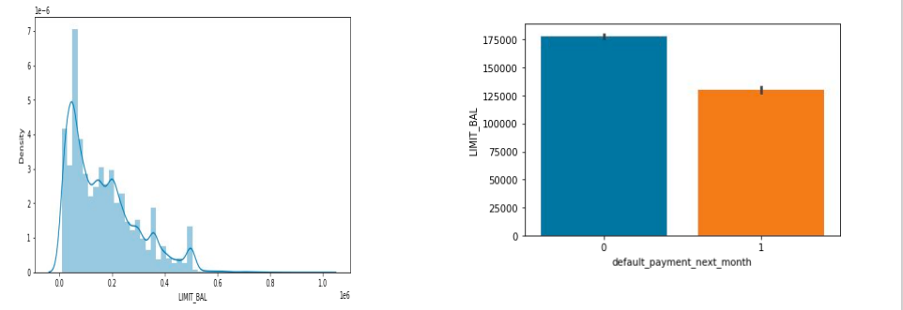
ANALYSIS OF LIMIT BALANCE VARIABLE
From the above plots analysis we can say that maximum amount of given credit in NT dollars is 50,000 followed by 30,000 and 20,000.

Slide 19
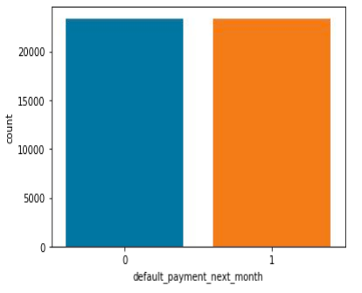
SMOTE
SMOTE (Synthetic Minority Oversampling
Technique) – Oversampling is one of the
most commonly used oversampling methods
to solve the imbalance problem. It aims to
balance class distribution by randomly
increasing minority class examples by
replicating them.
After performing SMOTE
operation we get this balance dataset

Slide 20
ONE HOT ENCODING
One hot encoding is a process by which categorical variables are converted into a form
that could be provided to ML algorithms to do a better job in prediction.
Here we perform one hot encoding on 'EDUCATION','MARRIAGE','PAY_SEPT',
'PAY_AUG', 'PAY_JUL', 'PAY_JUN', 'PAY_MAY', 'PAY_APR‘.
and label encoding for ‘SEX’
After this we get these features in our dataset:
(['LIMIT_BAL', 'SEX', 'AGE', 'BILL_AMT_SEPT', 'BILL_AMT_AUG','BILL_AMT_JUL', 'BILL_AMT_JUN', 'BILL_AMT_MAY', 'BILL_AMT_APR','PAY_AMT_SEPT', 'PAY_AMT_AUG', 'PAY_AMT_JUL', 'PAY_AMT_JUN','PAY_AMT_MAY', 'PAY_AMT_APR', 'default_payment_next_month','total_Payement_Value', 'Dues', 'EDUCATION_graduate school','EDUCATION_high school', 'EDUCATION_others', 'EDUCATION_university','MARRIAGE_married', 'MARRIAGE_others', 'MARRIAGE_single', 'PAY_SEPT_-1','PAY_SEPT_0', 'PAY_SEPT_1', 'PAY_SEPT_2', 'PAY_SEPT_3', 'PAY_SEPT_4','PAY_SEPT_5', 'PAY_SEPT_6', 'PAY_SEPT_7', 'PAY_SEPT_8', 'PAY_AUG_-1','PAY_AUG_0', 'PAY_AUG_1', 'PAY_AUG_2', 'PAY_AUG_3', 'PAY_AUG_4','PAY_AUG_5', 'PAY_AUG_6', 'PAY_AUG_7', 'PAY_AUG_8', 'PAY_JUL_-1','PAY_JUL_0', 'PAY_JUL_1', 'PAY_JUL_2', 'PAY_JUL_3', 'PAY_JUL_4','PAY_JUL_5', 'PAY_JUL_6', 'PAY_JUL_7', 'PAY_JUL_8', 'PAY_JUN_-1','PAY_JUN_0', 'PAY_JUN_1', 'PAY_JUN_2', 'PAY_JUN_3', 'PAY_JUN_4','PAY_JUN_5', 'PAY_JUN_6', 'PAY_JUN_7', 'PAY_JUN_8', 'PAY_MAY_-1', 'PAY_MAY_0', 'PAY_MAY_1', 'PAY_MAY_2', 'PAY_MAY_3', 'PAY_MAY_4','PAY_MAY_5', 'PAY_MAY_6', 'PAY_MAY_7', 'PAY_MAY_8', 'PAY_APR_-1','PAY_APR_0', 'PAY_APR_1', 'PAY_APR_2', 'PAY_APR_3', 'PAY_APR_4','PAY_APR_5', 'PAY_APR_6', 'PAY_APR_7', 'PAY_APR_8']

Slide 21

Machine Learning Model – Classification

Slide 22

MODEL BUILDING
LOGISTIC REGRESSION
RANDOM FOREST
SVC
XGBOOST

Slide 23
LOGISTIC REGRESSION
PARAMETERS
{'C': 0.01, 'penalty': 'l2'}
From this regression model we get the results as below:
The accuracy on test data is
0.7553984825886778
The precision on test data is
0.6936446173800259
The recall on test data is
0.7913583900562297
The f1 on test data is
0.7392867016864806
The roc_score on test data is
0.7593522874903104

Slide 24
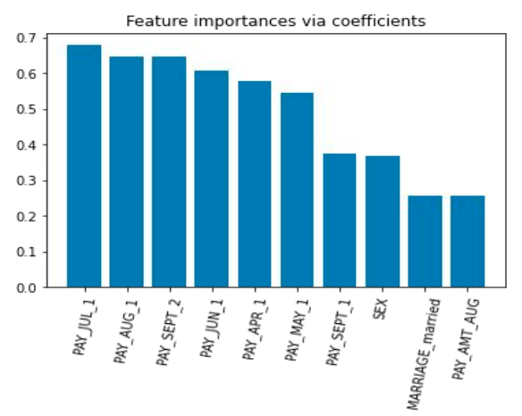
FEATURE IMPORTANCES

Slide 25
RANDOM FOREST
PARAMETERS :
{'max_depth': 30, 'n_estimators': 150}
From the regression model we get the
results as below:
The accuracy on test data is
0.8337332209324947
The precision on test data is 0.8020752269779508
The recall on test data is
0.856272500692329
The f1 on test data is
0.8282882400214305
The roc_score on test data is 0.8350761210621055

Slide 26
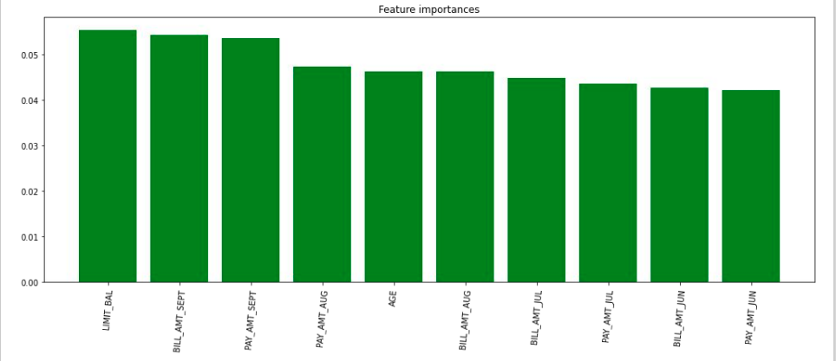
FEATURE IMPORTANCES

Slide 27
SUPPORT VECTOR CLASSIFIER (SVC)
PARAMETERS :
{'C': 10, 'kernel': 'rbf'}
From the regression model we get the
results as below:
The accuracy on test data is
0.766746644186499
The precision on test data is 0.6900129701686122
The recall on test data is
0.8150758388233492
The f1 on test data is
0.7473484582426073
The roc_score on test data is 0.7731776765513193

Slide 28
XGBOOST
PARAMETERS :
{‘max_depth’: 15
‘min_child_weight’: 8}
From the regression model we get the results as below
The accuracy on test data is
0.787562414888788
The precision on test data is
0.7316472114137483
The recall on test data is
0.8237441588785047
The f1 on test data is
0.7749690891605989
The roc_score on test data is
0.7912025355223038

Slide 29
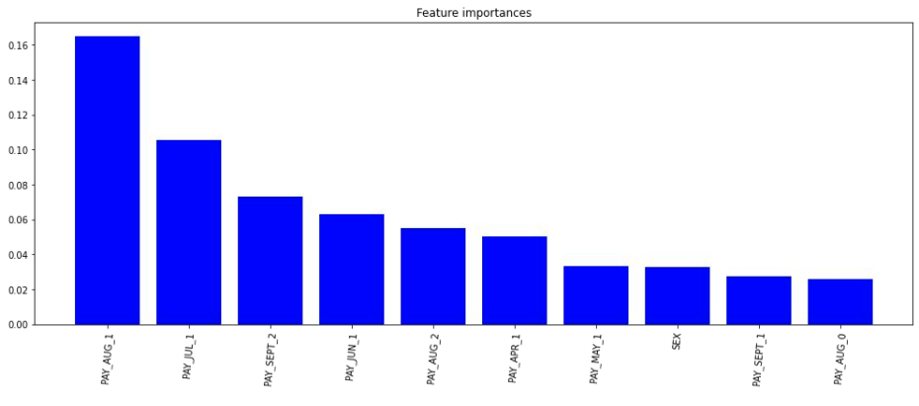
FEATURE IMPORTANCES

Slide 30
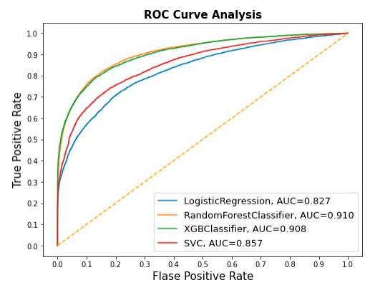
AUC-ROC CURVE COMPARISON
An ROC curve (receiver operating
characteristic curve) is a graph
showing the performance of a
classification model at all
classification thresholds.
This curve plots two parameters:
1. True Positive Rate
2. False Positive Rate
AUC stands for "Area under the
ROC Curve." That is, AUC measures
the entire two-dimensional area
underneath the entire ROC curve.

Slide 31
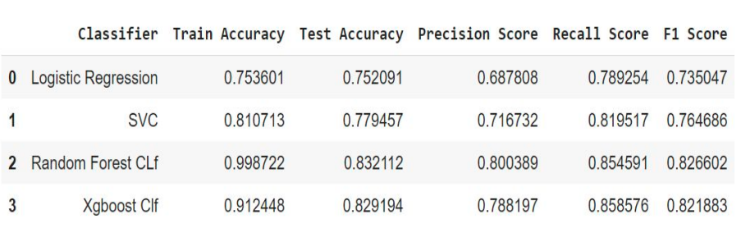
EVALUATING THE MODELS
From the above table we can find that XGBoost classifier perform best among those models

Slide 32
CHALLENGES FACED
The data was huge and was to be handled keeping in mind that we do not miss anything which is even of a little relevance.
Computation time.
Getting a higher accuracy on the models.
Carefully handling feature imbalanced data.
Tuning of hyperparameters carefully.
Feature engineering

Slide 33
CONCLUSION
XGBoost model has the highest recall, if the business cares recall the most, then this model is the best candidate. If the balance of recall and precision is the most important metric, then Random Forest is the ideal model. Since Random Forest has slightly lower recall but much higher precision than Logistic Regression, I would recommend Random Forest.
Gradient boost gave the highest accuracy of 82% on test dataset. Repayment in the month of september tended to be the most important feature for our machine learning model.
The best accuracy is obtained for the Random forest and XGBoost classifier.
In general, all models have comparable accuracy. Nevertheless, because the classes are imbalanced (the proportion of non-default credit cards is higher than default) this metric is misleading.
From the table in the previous slide we can see that XGBoost Classifier having Recall, F1-score, and ROC Score values equals 82%, 77%, and 86% and Random forest Classifier having Recall, F1-score, and ROC Score values equals 81%, 75%, and 84%.
XGBoost Classifier and Decision Tree Classifier are giving us the best Recall, F1-score, and ROC Score among other algorithms. We can conclude that these two algorithms are the best to predict whether the credit card is default or not default according to our analysis.

Slide 34



